Slide 1
python
Vikas Jaat

Slide 2

INTRODUCTION

Slide 3

Agenda-WW01D01
What is python
Why Python
Python Use cases
Python Installation
VS and Jupyter Notebook Setup
Executing First Python Script

Slide 4
What is Python Why Python
Python is a general-purpose, interpreted, object-oriented, high-level programming language.
It is an open-source programming language with more than 1 lakh libraries and more than 2 lakh active contributors.
Python is also known for its simplicity as compared to other programming languages.

Slide 5
Python Use cases
Be it Artificial Intelligence or Web Development or IoT or Big Data Analysis or Cloud Application Development or Automation domain you can find n number of use cases for Python
For example:
Instagram is coded in Python.
It is one of the main languages used by Google engineers.
Netflix uses Python to build its recommendation algorithms.
The Dropbox desktop application is developed in Python.
Reddit is coded in Python.

Slide 6
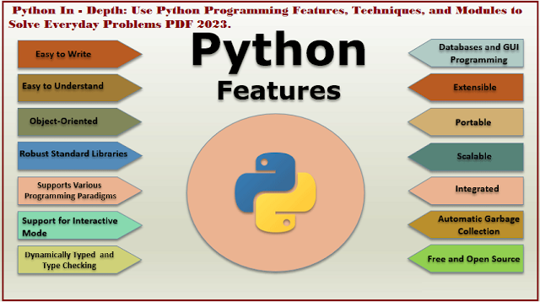

Slide 7
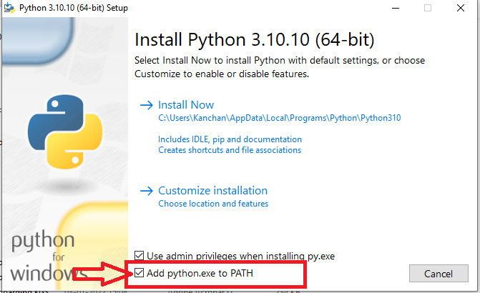
Python Installation
https://www.python.org/downloads/
System > About
VS IDE
Jupyter Notebook Plugin
ipykernel

Slide 8
Executing First Python Script
Code—The standard code cell. This one is reserved for writing and running Python code! You can run your code by clicking on the Run button, as seen previously.
Markdown—A text cell that is mainly used for notebook documentation, to write comments, titles, equations, etc. This type lets you structure your text using HTML tags or Markdown syntax.
For example, we could create a title. To do this, simply add a # in front of your text. A single # will correspond to a level one title, two ## to a level two title, etc.

Slide 9
Agenda-WW01D02
What is Jupyter Notebook, and How to use it?
Markdown Vs Coding in Jupyter Notebook
Why do we need Data Types
Built-in Data Types.
What are different uses of Data Types.

Slide 10
Visual Studio code AND JUPYTER NOTEBOOK https://code.visualstudio.com/docs/datascience/jupyter-notebooks

Slide 11
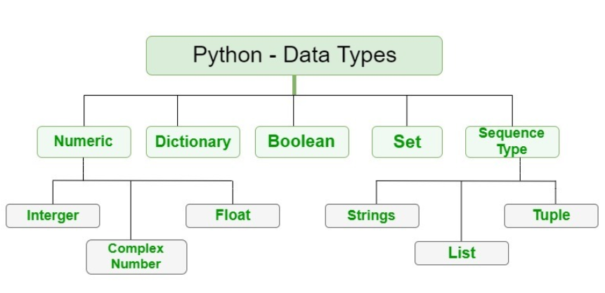
Built-in Data TYPES

Slide 12

Data Type ConversioN (Typecasting)
You can force the conversion of a variable into a well-defined type
int() : for integers
float() : for decimals
str(): for strings

Slide 13
Agenda-WW01D03
VS Code and Data Types | Revision

Slide 14
RECAP

Slide 15

print()
print() is a built-in function in Python that is used to output messages or values to the console or other standard output devices. It can be used to display strings, numbers, variables, and expressions.

Slide 16

BREAK

Slide 17

DATA STRUCTRES
Various data structures are used to organize and manipulate data. Some common data structures in Python include lists, tuples, dictionaries, sets, arrays, and queues.
To access an element in a data structure, you can use its index. The index of an element refers to its position in the data structure.

Slide 18
Agenda-WW01D04
Variable Assignment
How does an Object is related to the name of the Object
How are Objects stored in Memory in Python?

Slide 19
COMMENTS
Single-line comments : These are comments that start with a hash symbol (#) and continue until the end of the line.
Multi-line comments : These are comments that span multiple lines and are enclosed in triple quotes (either single or double quotes).

Slide 20
Indentation
Python relies on indentation (whitespace at the beginning of a line) to define scope in the code. Other programming languages often use curly-brackets for this purpose.
The most common use of indentation is in control flow statements like if/else statements, for and while loops, and function definitions

Slide 21


Understand What a Variable IS
Variables are one of the concepts found in all programming languages. You might as well say that without a variable, you can't program, and that's not an exaggeration.
Think of a variable as a kind of box containing a value
A value is what you will store in a variable.

Slide 22
VARIABLE Assignment
Assign values to variables using the equals sign (=)
variable_name = value
Python is a dynamically typed language, which means that you don't have to specify the type of a variable when you declare it. The type of the variable is inferred from the value you assign to it.

Slide 23
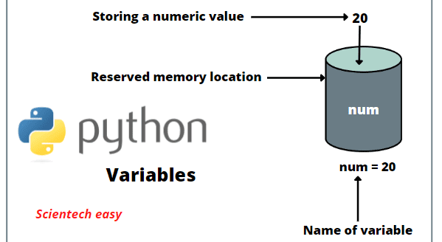

Slide 24
some general recommendations
Use clear variable names
It sounds tedious to do, but it is beneficial for you and the people you will share your code with—it makes it easier to read and maintain your code.
For example, savingsAccount and checkingAccount are much more explicit names than account1 and account2 .
Use explicit variable names
Avoid abbreviations and acronyms, if possible, even if an abbreviation may seem obvious.
For example, annualIncome is better than annualInc
Follow a typographic convention
One of the most common typographic conventions is called camel case (also known as camel caps). It involves writing variable names containing several words without spaces or punctuation—the first word is written in lowercase, then each word is written with the first letter in upper case, as shown above.

Slide 25

Multiple Assignment
Many Values to Multiple Variables
x, y, z = "Orange", "Banana", "Cherry“
One Value to Multiple Variables
x = y = z = "Orange"

Slide 26
BREAK

Slide 27

Object
An object is an instance of a class that encapsulates data and behavior.
Every value in Python is an object, including simple types like integers and floats, as well as more complex types like lists, dictionaries, functions, and classes themselves.
When you create an object in Python, you are creating an instance of a class.
An object and its name are related through a process called variable assignment. When you assign a value to a variable in Python, you are creating a reference to an object in memory.
For example, if you create a string object "s" by assigning a value to a variable, you are creating an instance of the built-in "str" class.

Slide 28
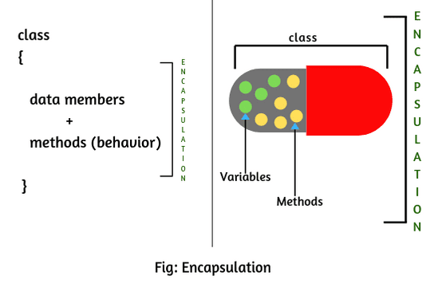
Object

Slide 29
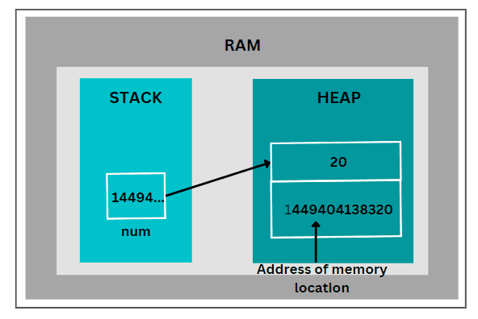
How are objects stored in memory
Objects are stored in memory dynamically.
When you create an object, Python allocates memory to store the object's data and behavior.
The amount of memory allocated depends on the type and size of the object
Python uses a private heap to store objects in memory.
In addition to the heap, Python also uses a stack to keep track of function calls and other operations.

Slide 30
Agenda-WW01D05
Immutability
Operators

Slide 31
IMMUTABILITY
In Python, objects can be classified into two categories: mutable and immutable.
Immutable objects are those whose value cannot be changed once they are created.
The following are examples of immutable objects.
Numbers (int, float, bool,…)
Strings
Tuples
Mutable objects, on the other hand, are those whose value can be changed once they are created.
The following are examples of mutable objects:
Lists
Sets
Dictionaries

Slide 32

OPERATORS
Arithmetic operators
Arithmetic operators are used with numeric values to perform common mathematical operations
Assignment operators
Assignment operators are used to assign values to variables
Comparison operators
Comparison operators are used to compare two values
Logical operators
Logical operators are used to combine conditional statements
Identity operators
Identity operators are used to compare the objects, not if they are equal, but if they are the same object, with the same memory location
Membership operators
Membership operators are used to test if a sequence is presented in an object
Bitwise operators
Bitwise operators are used to compare (binary) numbers

Slide 33
Agenda-WW01D06
Conditional Statements
Nested If-else
for loop Basic Introduction

Slide 34
Last session remaining topics
1- Recap
2- Bitwise Operators
4- Few Key points related to Set and Dictionary wrt Immutability
3- Operator Precedence

Slide 35
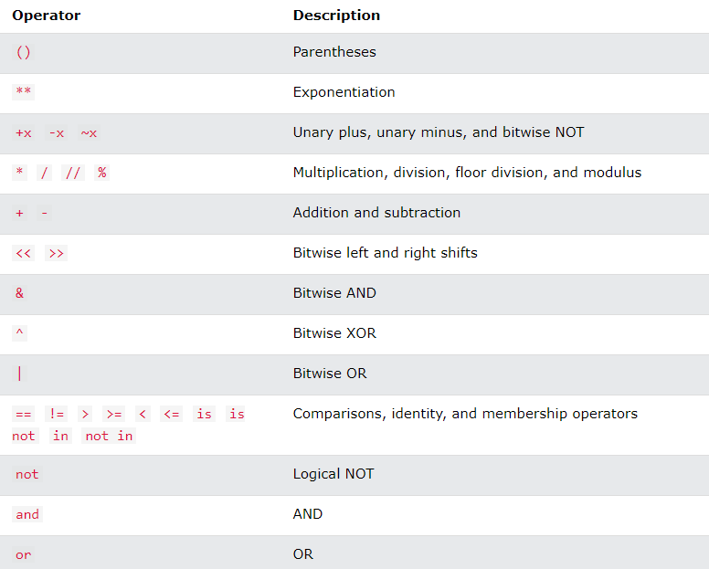
Operator precedence
Operator precedence describes the order in which operations are performed.
NOTE: If two operators have the same precedence, the expression is evaluated from left to right.

Slide 36
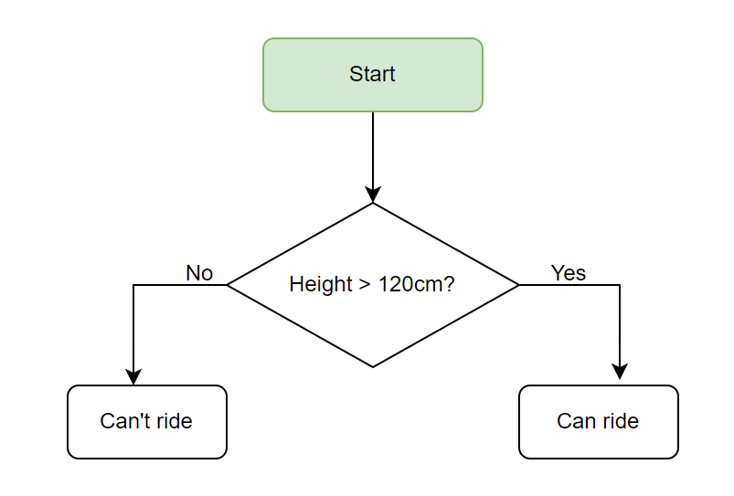
If | elif | else statements
CONDITIONALstatements
Conditional Statement in Python perform different computations or actions depending on whether a specific Boolean constraint evaluates to true or false. Conditional statements are handled by IF statements in Python

Slide 37
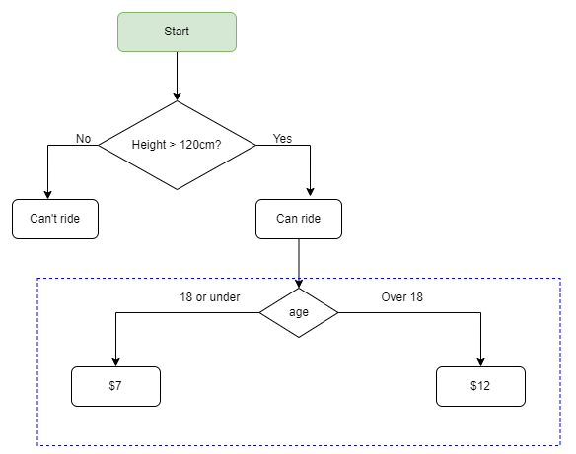
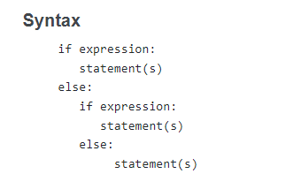
nested if else

Slide 38
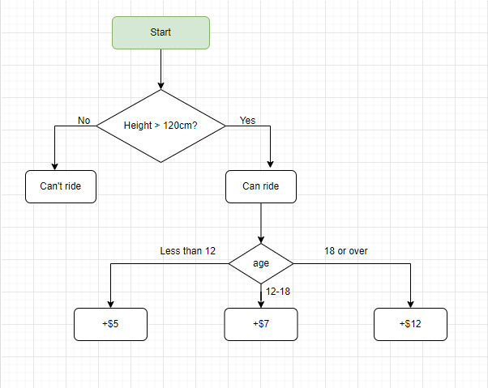
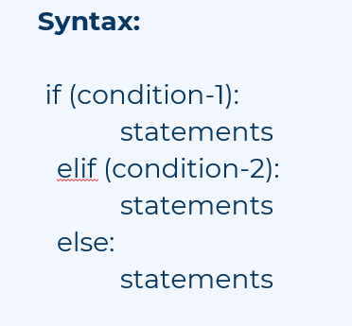
if | ELIF I else

Slide 39
BREAK

Slide 40
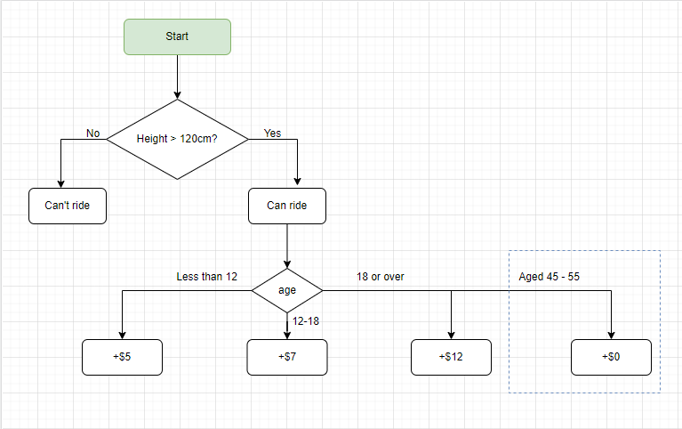
LOGICAL Operators with IF Statement

Slide 41
FOR LOOP
For loops are used for sequential traversal
e.g. for [user_defined_variable] in [iterable_datatype]:
# code inside for loop
statements
# code outside for loop
Code:
list = [1,2,3]
for i in list:
print(i)
Output:
1
2
3

Slide 42
Agenda-WW01D07
bool()
slicing
Iterables
Practice

Slide 43
bool()
bool() is a built-in Python function that returns a boolean value representing the truth value of an object.
The function takes one argument and returns True or False based on the truth value of the argument
Example 1: Using bool() with numeric values
print(bool(0)) # Output: False
print(bool(1)) # Output: True
print(bool(-1)) # Output: True
Example 2: Using bool() with strings
print(bool("")) # Output: False
print(bool("abc")) # Output: True
Example 3: Using bool() with lists
my_list = []
print(bool(my_list)) # Output: False
my_list = [1, 2, 3]
print(bool(my_list)) # Output: True

Slide 44
Slicing in different data types
Slicing is a technique in Python that allows you to extract a portion of a sequence, such as a string, list, or tuple.
Syntax :
[start:stop:step], where start is the index of the first element, stop is the index of the last element , and step is the step size between elements .
Example 1: Slicing a string
my_string = "Hello, World!"
print(my_string[0:5]) # Output: Hello
print(my_string[7:12]) # Output: World
print(my_string[0:12:2]) # Output: Hlo,Wrd
Example 2: Slicing a list
my_list = [1, 2, 3, 4, 5]
print(my_list[1:3]) # Output: [2, 3]
print(my_list[::2]) # Output: [1, 3, 5]
Example 3: Slicing a tuple
my_tuple = (1, 2, 3, 4, 5)
print(my_tuple[1:3]) # Output: (2, 3)
print(my_tuple[::2]) # Output: (1, 3, 5)

Slide 45
Iterables
An iterable is any object capable of returning its elements one at a time, allowing iteration over the elements
Most common iterables are strings, lists, tuples, and dictionaries, but other objects can be iterated as well, such as sets, files, and generators.
Example 1: Iterating over a string
my_string = "Hello, World!"
for char in my_string:
print(char)
Example 2: Iterating over a list
my_list = [1, 2, 3, 4, 5]
for item in my_list:
print(item)
Example 3: Iterating over a dictionary
my_dict = {'a': 1, 'b': 2, 'c': 3}
for key in my_dict:
print(key, my_dict[key])

Slide 46
Questions to practice for if else
Programming Practice
https://csiplearninghub.com/python-if-else-conditional-statement-practice/
Quiz
https://realpython.com/quizzes/python-conditional-statements/

Slide 47
Agenda-WW01D08
for loop
range(), len()
help()
Nested for loop
for loop practice

Slide 48
FOR LOOP RECAP

Slide 49
range()
The range() function is a built-in function in Python that generates a sequence of numbers.
Syntax:
range(start, stop, step)
start: (optional) The starting number of the sequence. If not specified, it defaults to 0.
stop: (required) The number at which the sequence stops (but doesn't include in the sequence).
step: (optional) The difference between each number in the sequence. If not specified, it defaults to 1.
Uses of range function
Generate sequence of numbers
With for loop for iteration

Slide 50
len()
len() is a built-in function that is used to return the number of items (elements) in an object.
The object could be a list, tuple, string, dictionary, set, or any other iterable object.
Syntax:
len( iterable_object)
Usage of len()
To calculate size
In loops

Slide 51
help()
help() function is a built-in function in Python that provides documentation on a specific Python object or module.
It can be used to get information about the function or module's purpose, arguments, return value, and usage examples
# Getting help on the 'print' function
help(int)

Slide 52
BREAK

Slide 53
Nested for loop
A nested for loop in Python is a loop that contains another loop within its block.
It is used to iterate over a collection of elements that are themselves collections, such as a list of lists or a dictionary of lists.
Syntax:
for variable1 in iterable1:
# outer loop code
for variable2 in iterable2:
# inner loop code

Slide 54
Agenda-WW01D09
while
nested loop
break
continue
pass
practice

Slide 55
while LOOP
while loop is used to execute a block of statements repeatedly until a given a condition is satisfied. And when the condition becomes false, the line immediately after the loop in program is executed.
e.g. while (condition):
# code inside while loop if condition is true
statements
# code outside while loop when condition is false
Code:
count = 0
while (count<2):
print(count)
count += 1
Output:
0
1

Slide 56
Nested loop
Nested loop means using another loop inside a loop.
e.g. while (condition):
# code inside while loop if condition is true
for [user_defined_vatiable] in [iterable_datatype]:
# this for loop is a nested loop inside a while loop
statements #inside for loop
statements # outside for loop and inside while loop
# code outside while loop when condition is false

Slide 57
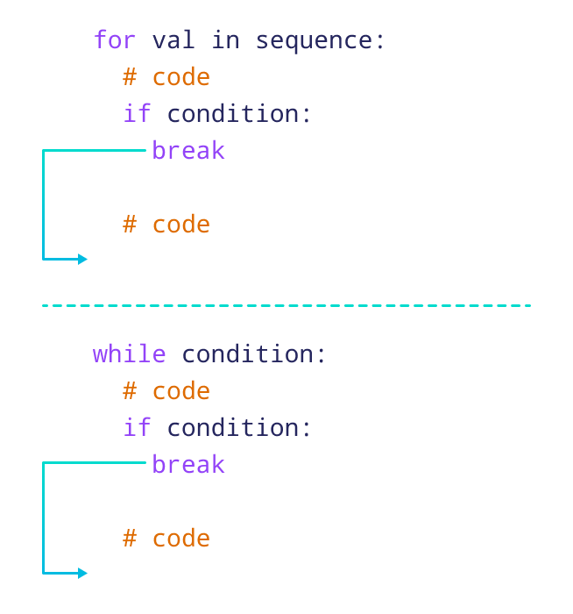
break
The break statement is used to terminate the loop. After that, the control will pass to the statements that are present after the loop, if available. If the break statement is present in the nested loop, then it terminates only those loops which contains break statement.
Syntax:
for [user_defined_vatiable] in [iterable_datatype]:
statements
some conditions:
break

Slide 58
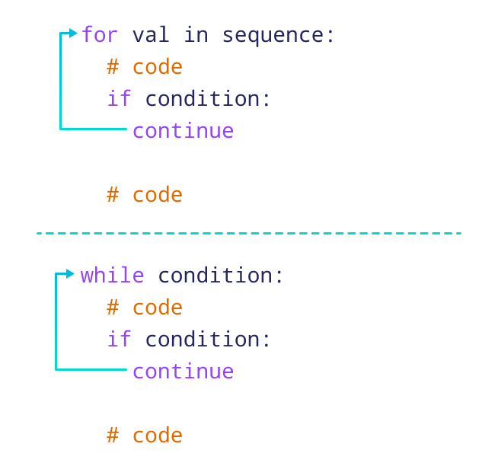
continue
Continue is also a loop control statement just like the break statement. continue statement is opposite to that of break statement, instead of terminating the loop, it forces to execute the next iteration of the loop.
When the continue statement is executed in the loop, the code inside the loop following the continue statement will be skipped and the next iteration of the loop will begin.
Syntax:
for [user_defined_vatiable] in [iterable_datatype]:
statements
some conditions:
continue

Slide 59
BREAK

Slide 60
pass
As the name suggests pass statement simply does nothing. The pass statement in Python is used when a statement is required syntactically but you do not want any command or code to execute. It is like null operation, as nothing will happen is it is executed. Pass statement can also be used for writing empty loops. Pass is also used for empty control statement, function and classes.
Syntax:
for [user_defined_vatiable] in [iterable_datatype]:
pass

Slide 61
Problems to practice on while loop
https://csiplearninghub.com/questions-of-while-loop-in-python/

Slide 62
Agenda-WW01D10
Strings
Practice Questions
input(), print()
split and join
builtin functions related to find
replace and count builtin funcitons
upper(),lower(),isupper(),islower(),title(),istitle(),capitalize()

Slide 63
STRINGS
A string is a sequence of characters. It can be declared in python by using double quotes. Strings are ordered(indexing and slicing operations can be perform).Strings are immutable, i.e., they cannot be changed.
e.g. a = “This is a string.”

Slide 64

input()
input() is a built-in Python function used for getting input from the user via the command line or console. It is commonly used to prompt the user to enter some data and then use that data in the program.
Note that the input() function always returns a string, so if you need to use the input as a different data type, you will need to cast it explicitly.

Slide 65
print()
print() is a built-in function in Python that is used to output messages or values to the console or other standard output devices. It can be used to display strings, numbers, variables, and expressions.
Syntax:
print(*objects, sep= ' ', end = '\n', file=file, flush=flush)
objects - object to the printed. * indicates that there may be more than one object
sep - objects are separated by sep. Default value: ' '
end - end is printed at last
file - must be an object with write(string) method. If omitted, sys.stdout will be used which prints objects on the screen.
flush - If True, the stream is forcibly flushed. Default value: False
It doesn't return any value; returns None

Slide 66

split()
split() is a built-in function in Python that allows you to split a string into a list of substrings based on a specified delimiter.
Syntax:
string.split(separator, maxsplit)
The separator argument is the delimiter that will be used to split the string. If it is not specified, the default delimiter is a space.
The maxsplit argument is optional and specifies the maximum number of splits to be performed. If it is not specified, all occurrences of the delimiter will be used for splitting.

Slide 67

join()
join() is a built-in function in Python used to join together a sequence of strings, where the string used as a separator is inserted between each of the original strings.
Syntax:
separator_string.join(iterable)
Separator_string is the string that will be used as a separator between the elements of the iterable object.

Slide 68
find()
This method is used to find the index of the first occurrence of a substring within a string. It returns -1 if the substring is not found.
Syntax:
str.find(substring, start=0, end=len(string))
substring - It is the substring to be searched in the str string.
start and end (optional) - The range str[start:end] within which substring is searched.
find() Return Value
The find() method returns an integer value:
If the substring exists inside the string, it returns the index of the first occurence of the substring.
If a substring doesn't exist inside the string, it returns -1.

Slide 69
index()
This method is similar to find(), but raises a ValueError exception if the substring is not found
count()
This method is used to count the number of occurrences of a substring in a string.
in
This operator is used to check if a substring is present in a string. It returns a boolean value (True or False)

Slide 70
Agenda-WW01D11
Different Patterns and Series
String built-in functions
Lists
Negative index and slicing
String Questions

Slide 71
Palindrome
A Palindrome is a series of letters, as a word, or a series of numbers, which says the same word when being read both in forward and backward directions.
EX: “radar”, “level”, 3553, 12321, 'Was it a car or a cat I saw'
Fibonacci sequence
A Fibonacci sequence is the integer sequence of 0, 1, 1, 2, 3, 5, 8....
The first two terms are 0 and 1. All other terms are obtained by adding the preceding two terms. This means to say the nth term is the sum of (n-1)th and (n-2)th term
Armstrong
A positive integer is called an Armstrong number of order n if
abcd... = a^n + b^n + c^n + d^n + ...
Ex: 153 = 1*1*1 + 5*5*5 + 3*3*3 // 153 is an Armstrong number.

Slide 72
Operations on string
1. lower() : Converts the string in lowercase.
e.g. a.lower() // output: ‘this is a string’
2. Upper() : Converts the string in uppercase.
e.g. a.upper() // output: ‘THIS IS A STRING’
3. isupper()/islower() : This gives true/false according to case of string lower or upper.
4. replace() : Replaces a word/letter in string.
e.g. variable_name.replace(“old:str”,”new:str”)
5. format() : We can use format function for formatting string in print statement .
e.g.
num1 = 50
print(“Value of num1 is {}”.format(num1))
For more such functions prefer python docs.
Link => https://docs.python.org/3/library/stdtypes.html#string-methods

Slide 73

LISTs
Lists are mutable sequences, typically used to store collections of heterogeneous items. Lists are ordered means indexing and slicing.
e.g.
l = [1, 2, 3, “abc”, [0, 1], {‘name’:’abc’, ’roll no’:123}, (a, b, c)]

Slide 74
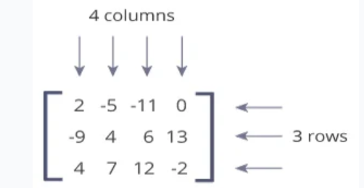
Nested List
List inside a List
A matrix is a two-dimensional data structure where numbers are arranged into rows and columns.
Eg:
matirx = [[1,3,3],[2,4,5],[5,6,7],[6,7,8]]

Slide 75
BREAK

Slide 76
Negative Indexing
Use negative indexes to start the slice from the end
Get the characters from position 5 to position 1, starting the count from the end of the list
Example
myList = ['A', 'B', 'C', 'D', 'E’]
print(myList[-1])

Slide 77
Negative Slicing in Python
Similar to negative indexing, Python also supports negative slicing. This means you can start slicing from the end of the sequence.
For example, let’s access the last 3 values of a list:
nums = [1, 2, 3, 4, 5, 6, 7]
part = nums[-4:-1]
print(part)
Here the slicing starts at the index -4 which is the 4th last element of the list. The slicing ends at the last item, which is at the index -1.
Also, the step size can be a negative value. By doing this, the direction of slicing is reversed. This means the slicing starts from the sequence[stop + 1] and stops at the sequence[start] value.

Slide 78
Agenda-WW01D12
Concatenation and ord()
Builtin Functions
Questions on Lists
Lists append, extend, insert, delete
Enumerate
Sort()

Slide 79
Operations on string
1- Concatenation of String :
We can concatenate strings using the "+" operator or the "join()" method.
string1 = "Hello"
string2 = "world"
result = string1 + " " + string2
print(result) # Output: "Hello world“
Note: Concatenation is supported by list as well.
2- ord() :
It is a built-in function in Python that takes a single character string as an argument and returns an integer representing the Unicode code point of that character.
char = 'A’
code_point = ord(char)
print(code_point) # Output: 65
NOTE: that the ord() function only works with a single character string. If you pass a string with more than one character or a non-string argument, Python will raise a TypeError.
https://www.geeksforgeeks.org/ascii-table/

Slide 80
Operations on lists
1. Add : To add item in a list.
i) append(): To add an item at the end of list.
e.g. l.append(item)
ii) extend(): To add many items at the end of list.
e.g. l.extend(item1,item2..etc.)
iii) insert(): insert an item at given index.
e.g. l.insert(index_value, item)
2. Update: To update or replace items in a list.
e.g. l[index] = new_value
3. Delete: To remove an item/element from list.
i) del list[index_value]: To remove an item from a given index value.
ii) remove(item): To remove a specific item.
iii) clear(): To remove/delete all element from list.
For more such functions prefer python docs.
Link 🡪 https://docs.python.org/3/library/stdtypes.html#sequence-types-list-tuple-range

Slide 81
index()
This method is similar to find(), but raises a ValueError exception if the item is not found in list
count()
This method is used to count the number of occurrences of a element in a list.
in
This operator is used to check if a element is present in a list. It returns a boolean value (True or False)

Slide 82

sort()
sort() is a built-in method in Python that can be used to sort a list in ascending order.
The method sorts the list in place, which means it modifies the original list.
Ex:
numbers = [3, 1, 4, 1, 5, 9, 2, 6, 5, 3, 5]
numbers.sort()
print(numbers) # Output: [1, 1, 2, 3, 3, 4, 5, 5, 5, 6, 9]
By default, the sort() method sorts the list in ascending order. However, you can also pass a reverse=True argument to sort the list in descending order:
Ex:
numbers = [3, 1, 4, 1, 5, 9, 2, 6, 5, 3, 5]
numbers.sort(reverse=True)
print(numbers) # Output: [9, 6, 5, 5, 5, 4, 3, 3, 2, 1, 1]

Slide 83
BREAK

Slide 84
enumerate
A lot of times when dealing with iterators, we also get a need to keep a count of iterations. Python eases the programmers’ task by providing a built-in function enumerate() for this task.
Enumerate() method adds a counter to an iterable and returns it in a form of enumerate object. This enumerate object can then be used directly in for loops or be converted into a list of tuples using list() method.
Syntax: enumerate(iterable, start)
Parameters:
i) Iterable: any object that support iteration
ii) start: the index value from which the counter is to be start by default it is 0.

Slide 85
Agenda-WW01D13
lstrip, rstrip, strip in Strings
Lists vs Tuples
Dictionary
Tuples
Use cases and Practice
Commonly Used builtin functions

Slide 86
lstrip()
Built-in string method that is used to remove leading whitespace characters from a string
Syntax:
string.lstrip([chars])
where string is the string that you want to strip the whitespace from, and chars is an optional parameter that specifies the set of characters to remove from the left side of the string.
Ex:
text = " hello world “
new_text = text.lstrip()
print(new_text)

Slide 87
rstrip()
Built-in string method that is used to remove leading whitespace characters from a string
Syntax:
string.rstrip([chars])
where string is the string that you want to strip the whitespace from, and chars is an optional parameter that specifies the set of characters to remove from the right side of the string.
Ex:
text = " hello world “
new_text = text.rstrip()
print(new_text)

Slide 88
strip()
Built-in string method that is used to remove leading whitespace characters from the beginning and end of a string
Syntax:
string.strip([chars])
where string is the string that you want to strip the whitespace from, and chars is an optional parameter that specifies the set of characters to remove from both end of the string.
Ex:
text = " hello world “
new_text = text.strip()
print(new_text)

Slide 89
TUPLE
A tuple is a sequence of immutable(can not update/change values in it) Python objects.
Tuples are sequences, just like lists.
The differences between tuples and lists are, the tuples cannot be changed unlike lists and tuples use parentheses, whereas lists use square brackets.
Creating a tuple is as simple as putting different comma-separated values in parentheses ().
Ex: Days in a week

Slide 90
Tuple vs LIST
Key points to remember:
The literal syntax of tuples is shown by parentheses () whereas the literal syntax of lists is shown by square brackets [] .
Lists has variable length; tuple has fixed length.
List has mutable nature; tuple has immutable nature.
List has more functionality than the tuple. Check using dir(list/tuple)

Slide 91

Commonly used Python builtin functions
sum() : This function is used to get the sum of a list or tuple.
min() : This function is used to get the minimum value in a list or tuple.
max(): This function is used to get the maximum value in a list or tuple.

Slide 92
Dictionary
Dictionaries are indexed by keys, which can be any immutable type; strings and numbers can always be keys.
Tuples can be used as keys if they contain only strings, numbers, or tuples; if a tuple contains any mutable object either directly or indirectly, it cannot be used as a key.
You can’t use lists as keys, since lists can be modified in place using index assignments, slice assignments, or methods like append() and extend().
It is best to think of a dictionary as a set of key: value pairs, with the requirement that the keys are unique (within one dictionary).
e.g. d = {‘name’:’abc’, ‘roll number’: 123}

Slide 93

Nested List and Dictionary
Nesting a List in a Dictionary
travel_log = { "France": ["Paris", "Lille", "Dijon"], "Germany": ["Berlin", "Hamburg", "Stuttgart"],}
Nesting Dictionary in a Dictionary
travel_log = { "France": {"cities_visited": ["Paris", "Lille", "Dijon"], "total_visits": 12}, "Germany": {"cities_visited": ["Berlin", "Hamburg", "Stuttgart"], "total_visits": 5},}

Slide 94
Agenda-WW01D14
Dictionary
Dictionary Methods
Sets
Operations on sets
Practice

Slide 95
Dictionary
len()
datatypes
dict constructor

Slide 96
Dictionary Methods
1. clear(): Remove all items from the dictionary.
2. copy(): Return a shallow copy of the dictionary.
3. fromkeys(seq[, v]): Return a new dictionary with keys from seq and value equal to v (defaults to None).
4. get(key[,d]): Return the value of key. If key does not exist, return d (defaults to None).
5. items(): Return a new view of the dictionary's items (key, value) as tuples.
6. keys(): Return a new view of the dictionary's keys.

Slide 97
Dictionary Methods
7. pop(key[,d]): Remove the item with key and return its value or d if key is not found. If d is not provided and key is not found, raises KeyError.
8. popitem(): Remove and return an arbitary item (key, value). Raises KeyError if the dictionary is empty.
9. setdefault(key[,d]): If key is in the dictionary, return its value. If not, insert key with a value of d and return d (defaults to None).
10. update([other]): Update the dictionary with the key/value pairs from other, overwriting existing value of keys.
11. values(): Return a new view of the dictionary's values

Slide 98

set
A set is a collection which is unordered and unindexed. In Python sets are written with curly brackets.
e.g. set = {"apple", "banana", "cherry"}
NOTE: Sets are unordered, so you cannot be sure in which order the items will appear.
You cannot access items in a set by referring to an index, since sets are unordered the items has no index.
Once a set is created, you cannot change its items, but you can add new items.

Slide 99
add()
we use the add() method to add an item to a set.
For example,
numbers.add(num)
update()
update() method is used to update the set with items other collection types (lists, tuples, sets, etc).
For example,
companies = {'Lacoste', 'Ralph Lauren’}
tech_companies = ['apple', 'google', 'apple']
companies.update(tech_companies)
print(companies)
# Output: {'google', 'apple', 'Lacoste', 'Ralph Lauren'}

Slide 100
discard()
We use the discard() method to remove the specified element from a set.
For example,
languages = {'Swift', 'Java', 'Python'}
print('Initial Set:',languages)
# remove 'Java' from a set
removedValue = languages.discard('Java')
print('Set after remove():', languages)

Slide 101
Operations on sets
Union: Gives all element from both sets without repetition. ( using “|” )
Intersection: Gives only common element from both sets. (using “&”)
Difference: Gives element of 1st set which are not present in 2nd set. (using “-”)
Symmetric Difference: Gives all those elements which are not common (using “^”)
e.g. A = {0, 2, 4, 6, 8}, B = {1, 2, 3, 4, 5}
Union : [0, 1, 2, 3, 4, 5, 6, 8]
Intersection : [2, 4]
Difference : [8, 0, 6]
Symmetric difference : [0, 1, 3, 5, 6, 8]

Slide 102
Agenda-WW01D15
About Functions
Functions Syntax and usages
Local, Global and Builtin Namespaces
Argument Passing Techniques

Slide 103
Dictionary iteration
We can iterate over a dictionary using the items() method. The items() method returns a view object that contains key-value pairs of the dictionary as tuples.
Ex:
fruits = {'apple': 2, 'banana': 4, 'orange': 1}
for key, value in fruits.items():
print(key,value)

Slide 104
FUNCTIONS
A function is a block of organized, reusable code that is used to perform a single, related action. Functions provide better modularity for your application and a high degree of code reusing.
As you already know, Python gives you many built-in functions like print(), etc. but you can also create your own functions. These functions are called user-defined functions.
Syntax:
def function_name(arguments):
# write all your code here
# outside of function

Slide 105
Defining a Function
You can define functions to provide the required functionality. Here are simple rules to define a function in Python.
Function blocks begin with the keyword def followed by the function name and parentheses ( ).
Any input parameters or arguments should be placed within these parentheses.
The code block within every function starts with a colon (:) and is indented.
The statement return [expression] exits a function.

Slide 106
Namespace
Namespace is a container that holds a set of identifiers (variable names, function names, class names, etc.) and maps them to their corresponding objects.
Built-in Namespace: This namespace contains all the built-in functions and exceptions that come with Python.
Global Namespace: This namespace contains all the identifiers that are defined in the global scope of a program. These identifiers are accessible from anywhere in the program.
Local Namespace: This namespace contains all the identifiers that are defined inside a function. These identifiers are accessible only within the function.

Slide 107
Scope of Variable:
Global variables are the one that are defined and declared outside a function, and we need to use them inside a function.
Local variables are defined inside a function.
Ex
a = “this is a global variable”
def local():
b = “this is a local variable”
print(a) # we can use a inside/outside function
print(b) # we cannot use b outside the function
Using global keyword, we can make a local variable global.
Ex
def func_name():
global b
b = “This is a local variable without ‘global b’ statement but now it is global variable ”
#outside the func we can use b
print(b)

Slide 108
BREAK

Slide 109
Argument Passing Techniques
1- Positional Arguments
Positional arguments are the most common way to pass arguments to a function.
They are matched based on their position, meaning the first argument passed is assigned to the first parameter in the function, the second argument to the second parameter, and so on.
Ex:
def add_numbers(x, y):
return x + y
result = add_numbers(3, 4)
print(result) # Output: 7

Slide 110
Argument Passing Techniques
2- Keyword Arguments
Keyword arguments are passed with the name of the parameter as a keyword.
This allows you to pass arguments in any order and to omit any arguments that have default values.
Ex:
def greet(name, message='Hello'):
print(f"{message}, {name}!")
greet(name='John') # Output: Hello, John!
greet(message='Hi', name='Kate') # Output: Hi, Kate!

Slide 111
Argument Passing Techniques
*args :
The special syntax *args in function definitions in python is used to pass a variable number of arguments to a function. It is used to pass a non-keyworded, variable-length argument list.
e.g.
def myFun(*argv):
for arg in argv:
print (arg)
myFun(‘Hello’, ‘Welcome’, ‘to’, ‘Edyoda’)
**kwargs :
The special syntax **kwargs in function definitions in python is used to pass a keyworded, variable-length argument list. We use the name kwargs with the double star. The reason is because the double star allows us to pass through keyword arguments
e.g.
def myFun(**kwargs):
for key, value in kwargs.items():
print ("%s == %s" %(key, value))
myFun(first ='assessments', mid ='edyoda', last='com')

Slide 112
return
return statement is used to return a value from a function.
When a return statement is encountered inside a function, the function immediately terminates and returns the specified value to the caller.
Function returns None by default.
None is a built-in object that represents the absence of a value or a null value.
def add_numbers(a, b):
result = a + b
return result
sum = add_numbers(10, 20)
print(sum) # Output: 30

Slide 113
Agenda-WW01D16
What are Modules
What are Packages
Modules in Detail
Packages in Detail

Slide 114

MODULES
A module is a file containing Python definitions and statements that can be imported into other Python files.
A module can define functions, classes, and variables, and can include runnable code.
Modules are used to organize code into logical and reusable units, making it easier to manage and maintain large programs.
By using modules, you can encapsulate functionality and keep it separate from other parts of your code.
This makes your code more modular and easier to understand and modify.

Slide 115
Type of MODULES
Built-in modules: These are modules that are included with Python itself and provide basic functionality. Examples include the os module for working with the operating system, the math module for mathematical operations, and the datetime module for working with dates and times.
Third-party modules: These are modules that are created by third-party developers and are not part of the Python standard library. They are usually installed using a package manager like pip. Examples include the numpy module for scientific computing, the pandas module for data analysis, and the requests module for working with HTTP requests.
Package modules: These are modules that are part of a package, which is a collection of related modules organized in a directory hierarchy. Each package contains an __init__.py file, which is executed when the package is imported. Examples include the numpy package, which contains modules for numerical computing, and the matplotlib package, which contains modules for data visualization.

Slide 116
MODULES
Python comes with a large number of built-in modules, such as math, os, and random, which provide commonly used functionality.
To use a module in Python, you typically need to import it using the import statement. For example, to use the math module, you would use the following code:
import math
x = math.sqrt(2)
print(x)

Slide 117

PACKAGE
Package is a collection of modules organized in a directory hierarchy.
A package is simply a directory containing one or more Python modules, along with a special file called __init__.py.
The __init__.py file is executed when the package is imported and can be used to perform initialization tasks or define package-level variables and functions.
Packages are used to organize related modules into a single namespace, making it easier to manage and reuse code.
By using packages, you can create a hierarchy of modules and sub packages, each with its own namespace.

Slide 118
BREAK

Slide 119
PACKAGE
Packages are named using the dot notation, with each level of the hierarchy separated by a dot.
For example, the numpy package is a popular package for scientific computing in Python, and it contains many subpackages and modules:
numpy
├── __init__.py
├── core
│ ├── __init__.py
│ ├── numeric.py
│ ├── shape_base.py
│ └── ...
├── fft
│ ├── __init__.py
│ ├── fft.py
│ └── ...

Slide 120
PACKAGE
To use a package in Python, you can import it using the import statement, just like you would with a module. For example, to import the numpy package, you would use the following code:
import numpy
x = numpy.array([1, 2, 3])
print(x)

Slide 121
Agenda-WW01D17
Modules in Detail
Packages in Detail

Slide 122
MODULES
In addition, there are many third-party modules available, which can be installed using package managers such as pip.
You can also import specific functions or variables from a module using the from keyword. For example, to import just the sqrt function from the math module, you would use the following code
from math import sqrt
root of 2
x = sqrt(2)
print(x)

Slide 123
Built-in modules
os: Provides a way of using operating system dependent functionality like reading or writing to the file system, manipulating paths, etc.
sys: Provides access to some variables used or maintained by the interpreter and to functions that interact strongly with the interpreter.
datetime: Provides classes for working with dates and times.
math: Provides mathematical functions like sqrt, sin, cos, etc.
random: Provides functions for generating random numbers.

Slide 124
Built-in modules
json: Provides functions for working with JSON (JavaScript Object Notation) data.
csv: Provides functions for working with CSV (Comma Separated Values) data.
re: Provides support for regular expressions (a powerful way of matching patterns in text).
time: Provides functions for working with time and dates.
urllib: Provides functions for working with URLs and HTTP.
collections: Provides a set of tools for working with collections of objects, like lists, tuples, and dictionaries.

Slide 125
MODULE ATTRIBUTES
Python module has its attributes that describes it. Attributes perform some tasks or contain some information about the module

Slide 126
Agenda-WW01D19
Text File Operations
File handling in detail

Slide 127
Os module
os.getcwd()
os.mkdir()
os.chdir()
os.remove()
os.rmdir()

Slide 128

File Handling
There are 5 Major operations that can be performed on a file are:
Creation of File
Opening an existing file
Reading data from a file
Writing data in a file
Closing a file
Python too support file handling and allow users to handle files i.e., to read and write files, along with many other file handling, to operate on files.
Syntax : open(filename, mode)

Slide 129
File OPERATIONS
File Handling
Mode for opening a file:
“r”, for reading.
“w”, for writing
“a”, for appending
“r+”, for reading and writing
Create File:
file = open(‘filename’, ‘w’)
file.write(data)
file.close()

Slide 130
File OPERATIONS
Read File:
file = open(‘fielname’, ‘r’)
print(file.read())
file.close()
Append File:
file = open(‘fielname’, ‘a’)
file.write(data)
file.close()

Slide 131
BREAK

Slide 132
File OPERATIONS
Using with() function:
code:
with open(filename) as file:
data = file.read()
print(data)
The advantage is that the file is properly closed after its suite finishes, even if an exception is raised at some point.
important function: readline(), write() etc.
for more built-in functions visit here: https://docs.python.org/3/tutorial/inputoutput.html#reading-and-writing-files

Slide 133
File OPERATIONS
readline(): It is used to read a single line from a file. When readline() is called repeatedly, it will read the file line by line until it reaches the end of the file.
with open('myfile.txt', 'r') as f:
line = f.readline()
while line:
print(line)
line = f.readline()
writeline() is not a built-in function in Python. Instead, you can use the write() function to write a string to a file, and then add a newline character (\n) to the end of the string to create a new line.
with open('myfile.txt', 'w') as f:
f.write('Line 1\n')
f.write('Line 2\n')
f.write('Line 3\n’)

Slide 134
File OPERATIONS
readlines() : To read all the lines of a file in a list
with open('myfile.txt', 'w') as f:
f.readlines(lines)
writelines() : To write multiple lines to a file. It takes an iterable as an argument and writes each element of the iterable to the file.
lines = ['Line 1\n', 'Line 2\n', 'Line 3\n']
with open('myfile.txt', 'w') as f:
f.writelines(lines)

Slide 135
Agenda-WW01D20
Text File Operations
File handling in detail
Regex Introduction

Slide 136
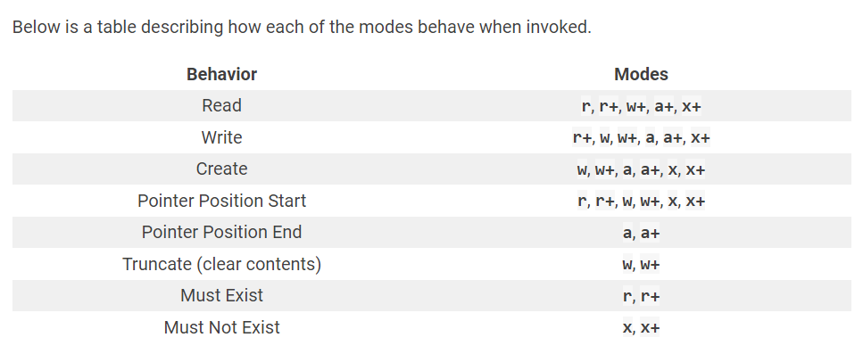
File OPERATIONS
‘x’ mode: Exclusive creation that fails if the file already exists.
'+’ is used to indicate that the file should be opened for both reading and writing.
‘b’ :Binary mode. Use this mode for non-textual files

Slide 137
File OPERATIONS
seek() – This function is used to change the position of the file pointer in a file. The syntax for the seek() function is:
file.seek(offset, whence) , whence means “from where”
0: The 0 value is used for setting the whence argument at the beginning of the file.
1: The 1 value is used for setting the whence argument at the current position of the file.
2: The 2 value is used for setting the whence argument at the end of the file.
Note: In text files (those opened without a b in the mode string), only seeks relative to the beginning of the file are allowed (the exception being seeking to the very file end with
seek(0, 2)) and the only valid offset values are those returned from the f.tell(), or zero
tell() – This function is used to return the current position of the file pointer in a file.
Current position in the file represented as number of bytes from the beginning of the file when in binary mode and an opaque number when in text mode
position = file.tell()
flush() – This function is used to flush the internal buffer of a file.

Slide 138
BREAK

Slide 139

Significance of 'r' before a string
Adding the letter "r" before a string is used to indicate that it is a "raw string". This means that escape characters (such as "\n" for a newline) will be ignored and the string will be treated as-is.
string = "This is a\nnew line."
Output:
This is a
new line.
string = r"This is a\nnew line.“
Output:
This is a\nnew line.

Slide 140
Regex
A RegEx, or Regular Expression, is a sequence of characters that forms a search pattern.
Ex: “\d+”, “\s”
RegEx can be used to check if a string contains the specified search pattern.
RegEx Module
Python has a built-in package called re, which can be used to work with Regular Expressions
Example:
re.search()
Used for searching a string for a specified pattern. It returns a match object if the pattern is found, otherwise, it returns None.
import re
string = "The quick brown fox jumps over the lazy dog.“
pattern = "fox“
result = re.search(pattern, string)
if result:
print("Pattern found")
else:
print("Pattern not found")

Slide 141
Special sequences -
‘\d’ - Matches any digit character
‘\s’ - Matches any whitespace character, including spaces, tabs, and newlines
NOTE: When the + sign is used with a special sequence in a regular expression pattern, it means that the special sequence should be matched one or more times.
Ex: ‘\d+’ , ‘\s+’

Slide 142
re module inbuilt functions
re.match(): Matches the pattern at the beginning of the string.
import re
pattern = r"regular expression pattern"
string = "string to match"
match_object = re.match(pattern, string)
re.findall(): Returns a list of all non-overlapping matches of the pattern in the string.
import re
pattern = r"regular expression pattern"
string = "string to search"
matches = re.findall(pattern, string)

Slide 143
re module inbuilt functions
re.sub(): Replaces all occurrences of the pattern in the string with a specified replacement string.
import re
pattern = r"regular expression pattern"
string = "string to search"
replacement = "replacement string"
new_string = re.sub(pattern, replacement, string)
re.split(): Splits the string into a list of substrings at each occurrence of the pattern.
import re
pattern = r"regular expression pattern"
string = "string to split"
split_list = re.split(pattern, string)

Slide 144
Agenda-WW01D21
Regex in Detail
Special Sequences

Slide 145
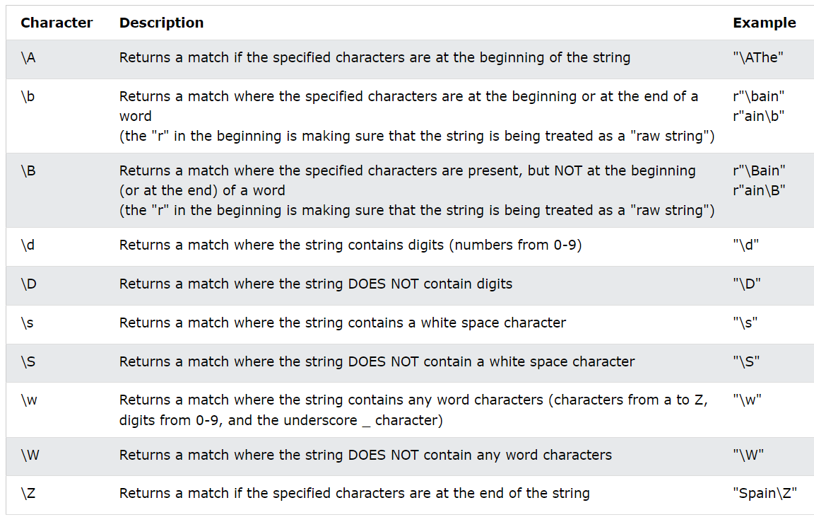
Special Sequences
Special sequences in Python regular expressions are a set of predefined patterns that match specific characters or character classes.

Slide 146
Agenda-WW01D22
Regex Sets
Grouping and capturing
Regex Metacharacters

Slide 147
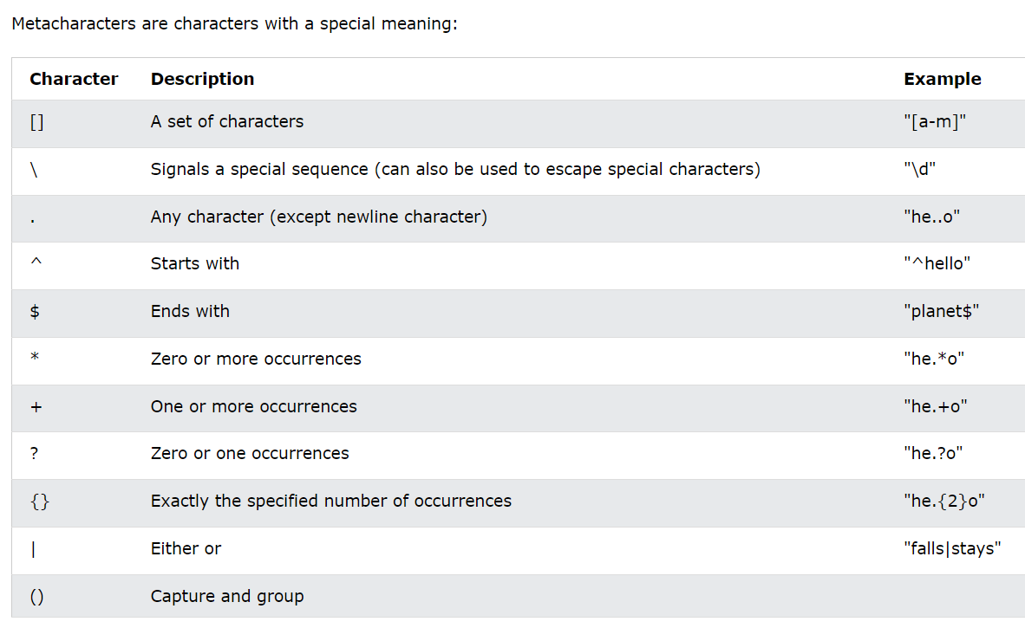
Metacharacters
Metacharacters are characters with a special meaning

Slide 148
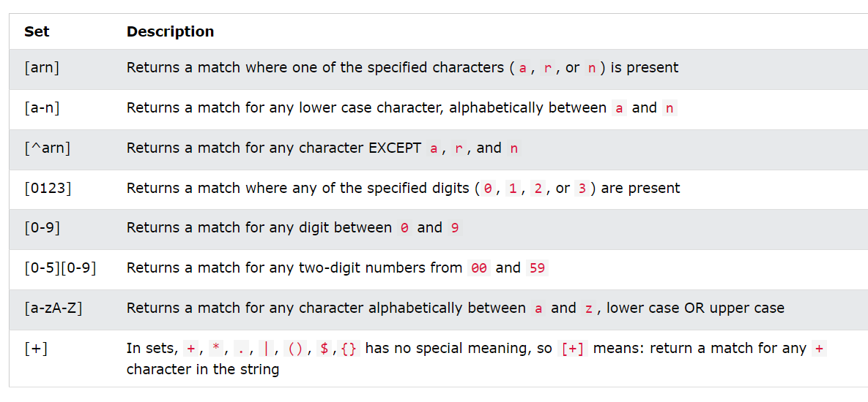
SETS
A set is a set of characters inside a pair of square brackets [] with a special meaning:

Slide 149
BREAK

Slide 150

Grouping and capturing
Grouping and capturing in Python regular expressions allow you to create subgroups within a regular expression and capture the matched text in those subgroup
Using parentheses to create subgroups.
string = "The price of an apple is $0.75 and the price of a banana is $0.50."
pattern = r"The price of (an|a) (\w+) is \$(\d+\.\d{2})“

Slide 151
Agenda-WW01D23
map
filter
lambda

Slide 152
map
The map() function takes a function and applies it to each element of an iterable (e.g., list, tuple, etc.) and returns a new iterable with the results.
Syntax:
map(function, iterable)
For example, if we want to square each element in a list of numbers, we could use the map() function as follows:
numbers = [1, 2, 3, 4, 5]
squared_numbers = map(lambda x: x**2, numbers)
print(list(squared_numbers)) # Output: [1, 4, 9, 16, 25]

Slide 153
FILTER
The filter() function takes a function and applies it to each element of an iterable, returning only the elements for which the function returns True.
Syntax:
filter(function, iterable)
For example, if we want to filter out all the even numbers in a list, we could use the filter() function as follows:
numbers = [1, 2, 3, 4, 5]
even_numbers = filter(lambda x: x % 2 == 0, numbers)
print(list(even_numbers)) # Output: [2, 4]

Slide 154
LAMBDA
A lambda function is a small anonymous function that can have any number of arguments but can only have one expression.
Lambda functions are often used as arguments to higher-order functions like map() and filter()
Syntax:
lambda arguments: expression
For example, we can define a lambda function that squares a number as follows:
square = lambda x: x**2
print(square(5))
# Output: 25

Slide 155
Agenda-WW01D24
lambda
List comprehension
Practice

Slide 156
Revision/Doubts
1- Function return statement
2- Matrix Problem

Slide 157
BREAK

Slide 158
List comprehension
List comprehension is a concise way of creating a new list in Python by applying an expression to each item in an existing list or iterable.
Syntax:
new_list = [expression for item in iterable if condition]
where:
new_list is the name of the new list being created
expression is the operation to be performed on each item in the iterable
item is the current item being processed in the iterable
iterable is the original list or other iterable to be processed
if condition is an optional condition that filters the items in the iterable before processing them
Example:
numbers = [1, 2, 3, 4, 5, 6, 7, 8, 9, 10]
even_numbers = [x for x in numbers if x % 2 == 0]
print(even_numbers) # Output: [2, 4, 6, 8, 10]

Slide 159
Difference/Usecase
List comprehension is used to create new lists based on existing lists, lambda functions are used to define small anonymous functions, map is used to apply a function to every element in a list, and filter is used to extract elements from a list based on a condition

Slide 160
Agenda-WW01D25
Live Project

Slide 161
Implementing a project
Understand the project requirements:
Before you start writing any code, make sure you understand what the project is asking for. Read the project instructions carefully and take note of any specific requirements, such as what functions you need to create, what input/output formats you need to use, and any limitations or constraints.
Plan your approach:
Once you have a clear understanding of the requirements, plan out how you will approach the project. Think about what modules, libraries, and data structures you may need to use, and how you will break the project down into smaller tasks. Consider writing an outline or pseudocode to help you organize your thoughts.
Write the code:
With a plan in place, start writing your code. Begin with the simplest tasks first, and work your way up to more complex ones. Make sure to test your code frequently as you go, to catch any errors early on.

Slide 162
Implementing a project
Debug and troubleshoot:
As you test your code, you will likely encounter errors and bugs. Use the error messages and debugging tools available in Python to identify and fix these issues.
Refactor and optimize:
Once your code is working correctly, look for ways to improve it. This may involve refactoring your code to make it more efficient, or optimizing it to reduce memory usage or improve runtime performance.
Document and test:
Finally, make sure to document your code thoroughly, so that others can understand and use it. Write comments, docstrings, and README files to explain what your code does and how to use it. Test your code thoroughly to ensure it is working as expected and meets the project requirements.

Slide 163

FACTS
The deck is unlimited in size.
There are no jokers.
The Jack/Queen/King all count as 10.
The Ace can count as 11 or 1.
Use the following list as the deck of cards:
cards = [11, 2, 3, 4, 5, 6, 7, 8, 9, 10, 10, 10, 10]
The cards in the list have equal probability of being drawn.
Cards are not removed from the deck as they are drawn.
The computer is the dealer.
http://blackjack-final.appbrewery.repl.run

Slide 164
RULES
Deal both user and computer a starting hand of 2 random card values.
Detect when computer or user has a blackjack. (Ace + 10 value card).
If computer gets blackjack, then the user loses (even if the user also has a blackjack
If the user gets a blackjack, then they win (unless the computer also has a blackjack).
Calculate the user's and computer's scores based on their card values.
5.Game ends immediately when user score goes over 21 or if the user or computer gets a blackjack.
6. Ask the user if they want to get another card.
7. Let the computer play.
The computer should keep drawing cards unless their score goes over 16.
8. Compare user and computer scores and see if it's a win, loss, or draw.
9. Print out the player's and computer's final hand and their scores at the end of the game.

Slide 165
Agenda-WW01D26
Why OOP
Objects and classes
What is OOP
Attributes and methods

Slide 166
Why OOP
Complexity because of Procedural Programming .
Complexity leads to confusion.
Code manageability becomes tough
Parallel coding when multiple members of a team working on same project.
Ex: A restaurant

Slide 167
What is OOP
OOP is a powerful programming model for software development because it makes it easier to write, maintain, and reuse code.
OOP allows programmers to create their own objects that have methods and attributes.
In general , OOP allows us to create code that is repeatable and organized.

Slide 168
Objects and classes
What is class?
A class is a blueprint or a template that defines the attributes and behaviors of a certain type of object.
class Car:
pass
What is Object ?
An object is an instance of a class. When we create an object, we are creating a unique instance of that class, with its own set of attributes and behaviors.
my_car = Car()
Multiple objects of a class can be created.

Slide 169
Attributes
What is attributes?
An attribute is a characteristic of an object.
In general variables are attributes.
The syntax for creating an attribute is:
self.attribute = something
There is a special method called: __init__()
This method is used to initialize the attributes of an object.
For example:
self.color = color
self.speed = 0

Slide 170
BREAK

Slide 171
Methods
What is methods?
A method is the behavior of the object.
In general functions are methods.
They are used to perform operations with the attributes of our objects.
Example:
def accelerate(self, acceleration):
self.speed += acceleration

Slide 172
Agenda-WW01D27
__init__ method
Class Attributes Vs Object Attributes
self keyword
Practice

Slide 173
__init__()
__init__ method is a special method that is automatically called when an object of a class is created.
It is used to initialize the object's attributes or properties.
The __init__ method is often referred to as the "constructor" method because it is similar to the constructor method in other programming languages.
However, it is important to note that __init__ is not a true constructor, as the object has already been created before __init__ is called.

Slide 174

self
The self keyword is used to refer to the instance of a class. It is a reference to the current object that the method or attribute is being called on.
When you create a class in Python, you can define methods and attributes that are associated with instances of that class.
When you create an instance of the class, you can then call those methods and access those attributes using the self keyword.

Slide 175

PRACTICE

Slide 176

Class attributes vs object attributes
Class attributes are attributes that are defined at the class level and are shared by all instances of the class.
They are defined outside of any method and are accessed using the class name.
Object attributes are attributes that are defined at the object level and are specific to each instance of the class.
They are defined inside the class methods and are accessed using the instance name.

Slide 177
Agenda-WW01D28
getters and setters
Class Methods
Polymorphism
Characteristics of OOPs
Encapsulation

Slide 178
Getter and setter
In python there is no strict concept of private attributes like in some other programming languages. However, we can use a convention to make an attribute private by adding a double underscore (__) prefix to its name.
Getter and setter methods are used to access and modify class attributes in a controlled way. Getter and setter methods are also known as accessor and mutator methods, respectively.
Getter Method:
A getter method is used to retrieve the value of a class attribute. In Python, getter methods are implemented using the @property decorator.
Setter Method:
A setter method is used to modify the value of a class attribute. In Python, setter methods are implemented using the @<attribute_name>.setter decorator.

Slide 179
Characteristics of OOP
Inheritance: Inheritance is a way to form new classes using classes that have already been defined. The newly formed classes are called derived classes, the classes that we derive from are called base classes.
Polymorphism: Polymorphism refers to the way in which different object classes can share the same method name, and those methods can be called from the same place
Modularity: OOP allows developers to break down complex software systems into smaller, more manageable pieces called objects. This makes it easier to write, maintain, and reuse code.
Encapsulation: OOP encourages developers to hide the internal workings of an object from the outside world. This means that changes to an object's implementation won't affect other parts of the system that use the object.

Slide 180
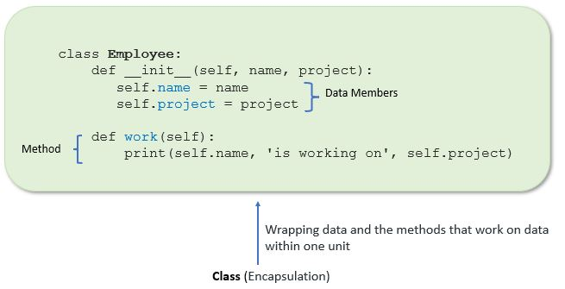
Encapsulation
It that enables the bundling of data and methods inside a single unit, preventing access to the internal data and methods from outside the unit, except through the public interface provided by the unit.
In Python, encapsulation can be achieved by using private and public access modifiers.
Advantages of Encapsulation
Security
Data Hiding
Simplicity

Slide 181
BREAK

Slide 182

Polymorphism
Polymorphism in Python is the ability of an object to take many forms. In simple words, polymorphism allows us to perform the same action in many different ways
In polymorphism, a method can process objects differently depending on the class type or data type. Let’s see simple examples to understand it better
Example:
The built-in function len() calculates the length of an object depending upon its type. If an object is a string, it returns the count of characters, and If an object is a list, it returns the count of items in a list.
Polymorphism is mainly used with inheritance.

Slide 183

Class Methods
Class methods are special methods that are bound to the class and not to the instance of the class.
Class methods are defined using the @classmethod decorator.
Class methods used to access or modify the class state.
In method implementation, if we use only class variables, then such type of methods we should declare as a class method.
The class method has a cls parameter which refers to the class.
Class method is also used as factory method to create object.

Slide 184
Agenda-WW01D29
Static methods
Dunder or magic methods
Practice
Operator overloading

Slide 185
static Methods
A static method is a general utility method that performs a task in isolation.
Inside this method, we don’t use instance or class variable because this static method doesn’t take any parameters like self and cls.
A static method is a method that belongs to a class rather than an instance of the class. It can be called without creating an instance of the class and operates on the class itself rather than an instance of the class.
To create a static method in Python, you can use the @staticmethod decorator.
Uses: A utility method that performs some calculation or formatting could be implemented as a static method.

Slide 186
Letter - f
Letter 'f' can be used to create a formatted string literal.
An f-string is a way to embed expressions inside string literals, using curly braces {}.
The syntax for f-strings is to prefix the string literal with the letter 'f', and include expressions inside curly braces {}.
The expressions are evaluated at runtime and their values are converted to strings and inserted into the string literal at the location of the corresponding curly braces.

Slide 187

Dunder/magic Methods
Dunder methods (short for "double underscore" methods) in Python are special methods that are surrounded by double underscores on both sides of the method name.
These are used to define various built-in operations and behaviors for objects in Python.
These methods are not actually called directly but by Python specific language syntax
__init__(self, ...): The constructor method that gets called when an object is created. It is used to initialize the object's attributes.
__str__(self): A method that returns a string representation of the object when the str() function is called on it.
__del__(self): It is used to define the behavior of an object when it is about to be destroyed, or deallocated, from memory. The __del__() method is automatically called by Python's garbage collector when an object is no longer being used or referenced by any other object in the program. Explicitly called using del
__len__(self): A method that returns the length of the object when the len() function is called on it.

Slide 188
BREAK

Slide 189
Operator overloading
In Python, we can change the way operators work for user-defined types.
For example, the + operator will perform arithmetic addition on two numbers, merge two lists, or concatenate two strings.
This feature in Python that allows the same operator to have different meaning according to the context is called operator overloading.

Slide 190
Agenda-WW01D30
Inheritance
Types of Inheritance
Method Overriding
Practice
super(), issubclass()

Slide 191

Inheritance
The process of inheriting the properties of the parent class into a child class is called inheritance.
The existing class is called a base class or parent class and the new class is called a subclass or child class or derived class.
The main purpose of inheritance is the reusability of code because we can use the existing class to create a new class instead of creating it from scratch.
In inheritance, the child class acquires all the data members, properties, and functions from the parent class. Also, a child class can also provide its specific implementation to the methods of the parent class.
Syntax:
class BaseClass:
Body of base class
class DerivedClass(BaseClass):
Body of derived class

Slide 192
Types of Inheritance
In Python, based upon the number of child and parent classes involved, there are five types of inheritance.
Single inheritance
Multiple Inheritance
Multilevel inheritance
Hierarchical Inheritance
Hybrid Inheritance

Slide 193
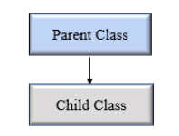
Single Inheritance
In single inheritance, a child class inherits from a single-parent class. Here is one child class and one parent class.

Slide 194
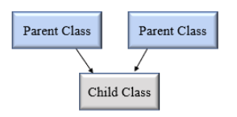
Multiple Inheritance
In multiple inheritance, one child class can inherit from multiple parent classes.
So here is one child class and multiple parent classes.

Slide 195
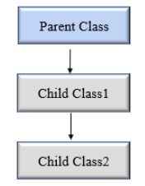
Mutilevel Inheritance
In multilevel inheritance, a class inherits from a child class or derived class.
Suppose three classes A, B, C. A is the superclass, B is the child class of A, C is the child class of B.
In other words, we can say a chain of classes is called multilevel inheritance.

Slide 196
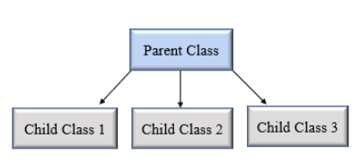
hierarchical Inheritance
In Hierarchical inheritance, more than one child class is derived from a single parent class.
In other words, we can say one parent class and multiple child classes.

Slide 197
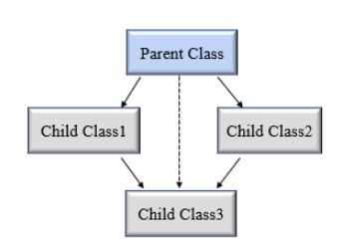
Hybrid Inheritance
When inheritance is consists of multiple types or a combination of different inheritance is called hybrid inheritance.

Slide 198
BREAK

Slide 199
super()
We can refer to parent class by using the super() function.
The super function returns a temporary object of the parent class that allows us to call a parent class method inside a child class method.

Slide 200
issubclass()
In Python, we can verify whether a particular class is a subclass of another class.
For this purpose, we can use Python built-in function issubclass()
This function returns True if the given class is the subclass of the specified class. Otherwise, it returns False.

Slide 201
Method overriding
In inheritance, all members available in the parent class are by default available in the child class.
If the child class does not satisfy with parent class implementation, then the child class is allowed to redefine that method by extending additional functions in the child class. This concept is called method overriding.
When a child class method has the same name, same parameters, and same return type as a method in its superclass, then the method in the child is said to override the method in the parent class.

Slide 202
Agenda-WW01D31
Unit Test
Debugging

Slide 203
Unit Test
A unit test is a type of software testing that involves testing individual units or components of a software application in isolation from the rest of the system.
The goal of unit testing is to verify that each unit of code behaves as expected and produces the correct output for a given input or set of inputs.
In the context of object-oriented programming, a unit typically refers to a single method or function in a class or module.
Unit tests are typically written by developers as they write their code, to help ensure that each unit of code behaves as intended and to catch any bugs or errors early in the development process.

Slide 204
test framework in python
Python provides several built-in unit testing frameworks that can be used to write and run unit tests for Python code.
unittest
nose Or nose2
Pytest
The most used unit testing framework in Python is the unittest module, which is part of the Python standard library.
The unittest framework provides a set of tools and methods for defining and running unit tests in Python, including test discovery, test fixtures, and assertion methods.

Slide 205
Unit test framework in python
Here is a basic overview of how to use the unittest framework:
Create a test case class that inherits from unittest.TestCase.
Define test methods in the test case class. Test methods should start with the word "test".
Use assertion methods in the test methods to check that the code being tested is behaving as expected.
Use a test runner to discover and run your tests. You can use the unittest.main() function to run all the tests in a module or the unittest.TextTestRunner class to run tests in a more customizable way.
Example:
import unittest
class MyTestCase(unittest.TestCase):
def test_addition(self):
self.assertEqual(2 + 2, 4)
def test_subtraction(self):
self.assertEqual(5 - 3, 2)
unittest.main()

Slide 206
Useful methods of unittest
assertEqual(): This method checks if two values are equal. If the values are not equal, it will raise an AssertionError with a specified message.
assertTrue() and assertFalse(): These methods check if a value is True or False, respectively.
assertIn() and assertNotIn(): These methods check if a value is present or absent in a list, tuple, or set.
assertRaises(): This method checks if an exception is raised when a particular function is called.
setUp() and tearDown(): These methods are called before and after each test method, respectively. They can be used to set up any necessary resources before running the tests and to clean up after the tests are finished

Slide 207
BREAK

Slide 208

Debugging
Debugging is the process of finding and fixing errors or bugs in your code.
Print Statements: The most basic debugging technique is to use print statements in your code to display the values of variables or expressions at different points in your code.
pdb: The Python debugger, or pdb, is a built-in tool that allows you to step through your code line by line and inspect variables and expressions as you go.
IDE Debugging: Many integrated development environments (IDEs) for Python, such as PyCharm or Visual Studio Code, provide advanced debugging features, such as breakpoints, variable inspection, and call stacks.
Logging: The Python logging module allows you to record messages at different levels of severity and output them to a file or console, providing a more systematic and structured approach to debugging.
Tracebacks: When an error or exception occurs in your code, Python generates a traceback that shows the line number and file name of the error, as well as the call stack leading up to the error.

Slide 209
pdb
pdb (Python Debugger) is a built-in module in Python that allows you to interactively debug your code.
It can be used to step through your code, set breakpoints, inspect variables, and more.
Here are the basic steps for using pdb to debug your Python code:
Import the pdb module at the beginning of your script.
Set a breakpoint in your code by calling the pdb.set_trace() function at the point where you want to start debugging.
Run your script as usual.
When the pdb.set_trace() line is reached during execution, the debugger will start and you will be able to interactively debug your code.
Use the n command to execute the current line and move to the next line, the s command to step into a function call, the r command to continue execution until the current function returns, and the c command to continue execution until the next breakpoint is reached.
Use the p command to print the value of a variable, and the q command to quit the debugger and exit the script.

Slide 210
Agenda-WW01D32
Exception Handling
Generators
Practice

Slide 211
Exception
In programming, an exception is an event that occurs during the execution of a program that disrupts the normal flow of instructions.
When an exceptional condition arises, such as an error or unexpected behavior, the program may stop executing, raise an error message, or take some other action to handle the situation.
In Python, exceptions are represented by objects that inherit from the built-in Exception class.
When an exceptional condition occurs in Python, an exception object is created and raised.
This causes the Python interpreter to search for an exception handler, which is a block of code that can handle the exception and continue executing the program.

Slide 212
Different types of Exception
SyntaxError: This exception is raised when the Python interpreter encounters a syntax error in your code.
TypeError: This exception is raised when you try to perform an operation on an object of the wrong type.
ValueError: This exception is raised when you pass an argument of the correct type but with an inappropriate value.
ZeroDivisionError: This exception is raised when you attempt to divide a number by zero.
IndexError: This exception is raised when you try to access an index that is out of range in a sequence like a list or a string.
KeyError: This exception is raised when you try to access a non-existent key in a dictionary.
AttributeError: This exception is raised when you try to access an attribute of an object that does not exist.
FileNotFoundError: This exception is raised when you try to access a file that does not exist.
IOError: This exception is raised when an input/output operation fails, such as when you try to read from a file that is not open.
KeyboardInterrupt: This exception is raised when the user interrupts the execution of the program by pressing Ctrl+C.

Slide 213
Exception handling
Exception handling is a mechanism in Python that allows you to handle errors that occur during the execution of a program.
Exceptions are raised when an error occurs in a Python program, and the interpreter is unable to continue the execution of the program.
To handle exceptions in Python, you use a try-except block.
The try block contains the code that might raise an exception, and the except block contains the code that handles the exception. Here's an example:
try:
# code that might raise an exception
except ExceptionType:
# code to handle the exception

Slide 214
BREAK

Slide 215
Generators
A generator function is a special type of function that allows you to iterate over a sequence of values without generating the entire sequence in memory at once.
Instead, the generator function yields a new value each time it is called, allowing you to generate the sequence on the fly.
A generator function is defined using the yield keyword instead of the return keyword.
When a generator function is called, it returns a generator object that you can use to iterate over the sequence of values.
Syntax:
def my_generator_function():
# Generator function body
yield value1
yield value2
...
yield valueN

Slide 216
next()
next() function is used to retrieve the next value from a generator.
When a generator is called with next(), it resumes execution from where it left off and continues until it encounters the next yield statement.
The value yielded by that yield statement is returned by the next() function.

Slide 217
Agenda-WW01D33
CSV File Handling
JSON File Handling
XML File handling

Slide 218
csv file handling
A CSV (Comma Separated Values) format is one of the most simple and common ways to store tabular data. To represent a CSV file, it must be saved with the .csv file extension.
If you open the above CSV file using a text editor such as notepad, you will see:
SN, Name, City
1, Michael, New Jersey
2, Jack, California
While we could use the built-in open() function to work with CSV files in Python, there is a dedicated csv module that makes working with CSV files much easier.

Slide 219
csv module
csv.writer: This function returns an object that can be used to write data to a CSV file.
csv.reader: This function returns an object that can be used to read a CSV file line by line, where each line is split into a list of fields.
csv.DictReader: This function returns an object that can be used to read a CSV file line by line, where each line is parsed into a dictionary with the column headers as keys and the field values as values
csv.DictWriter: This function returns an object that can be used to write data to a CSV file, where each row is a dictionary with the column headers as keys and the field values as values.

Slide 220
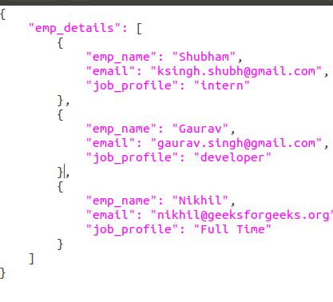
json file handling
The full-form of JSON is JavaScript Object Notation. It means that a script (executable) file which is made of text in a programming language, is used to store and transfer the data.
Python supports JSON through a built-in package called json. To use this feature, we import the json package in Python script.
The text in JSON is done through quoted-string which contains the value in key-value mapping within { }.

Slide 221
json module
json.loads: This function converts a JSON string into a Python object.
json.dumps: This function converts a Python object into a JSON string.
json.load: This function reads a JSON file and returns a Python object.
json.dump: This function writes a Python object to a JSON file

Slide 222
BREAK

Slide 223
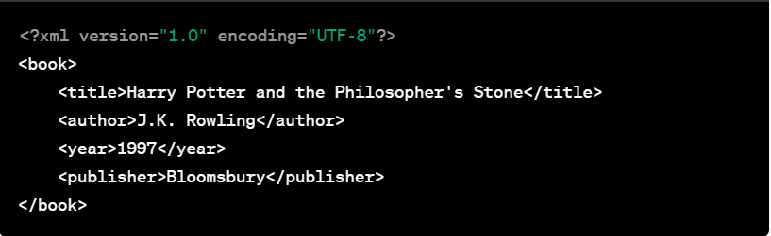
xml file handling
Python has a built-in module called xml for parsing and handling XML files.
Import the xml.etree.ElementTree module: The ElementTree module is part of the xml module and provides a simple way to parse and manipulate XML files in Python.
Load the XML file: Use the ElementTree.parse() method to load the XML file into a tree structure.
Access the elements of the XML file: You can access the elements of the XML file using the Element object
Modify the XML file: You can modify the XML file by manipulating the Element objects. For example, to add a new child element to the root element
Save the modified XML file: Use the ElementTree.write() method to save the modified XML file.

Slide 224
Agenda-WW01D34
Request Module
BeautifulSoup
Data Extraction using fin, find_all

Slide 225
Request Module
Beautiful Soup is a Python library that is used for web scraping purposes to pull the data out of HTML and XML files. It creates a parse tree from page source code that can be used to extract data in a hierarchical and more readable manner.

Slide 226
Beautiful Soup
Beautiful Soup is a Python library that is used for web scraping purposes to pull the data out of HTML and XML files. It creates a parse tree from page source code that can be used to extract data in a hierarchical and more readable manner.

Slide 227
Data Extraction using fin, find_all
Python has a built-in module called xml for parsing and handling XML files.
Import the xml.etree.ElementTree module: The ElementTree module is part of the xml module and provides a simple way to parse and manipulate XML files in Python.
Load the XML file: Use the ElementTree.parse() method to load the XML file into a tree structure.
Access the elements of the XML file: You can access the elements of the XML file using the Element object
Modify the XML file: You can modify the XML file by manipulating the Element objects. For example, to add a new child element to the root element
Save the modified XML file: Use the ElementTree.write() method to save the modified XML file.

Slide 228



Summary
With PowerPoint, you can create presentations and share your work with others, wherever they are. Type the text you want here to get started. You can also add images, art, and videos on this template. Save to OneDrive and access your presentations from your computer, tablet, or phone.

Slide 229




Thank you
Presenter name
Email address
Website

